Slide 1

Concept Video Design

Slide 2
The Problem
The Problem
Mainly focuses on the popular attractions, don’t consider hidden gems.
->areas become crowded, no sense of adventure.
Doesn’t always suggest the area, only provide details on popular tourist locations
->there’s no accessible information for users.

Slide 3
Our Solution
Less top attractions and crowded areas, more hidden gems and adventures.
Lets the user move freely using the interactive map, when selecting the attraction they want to visit.
->Suggest a variety of routes in regards to transportation to the destination.
More specific to the area, however still suggests attractions that are meets needs and wants of the user.
-> alternative and convenient way to discover more about the local area

Slide 4
Three Tasks
TASK 1 – EASY: BROWSE
Find attractions that are relevant to the user meeting their specific needs and wants, selecting from the suggested areas.
TASK 2 – MEDIUM: FIND
Locating the desired attraction chosen using the interactive map, using the suggested forms of transport.
TASK 3 – HARD: RECOMMEND
Informing people know what they enjoyed about the attraction by providing a rating.

Slide 5
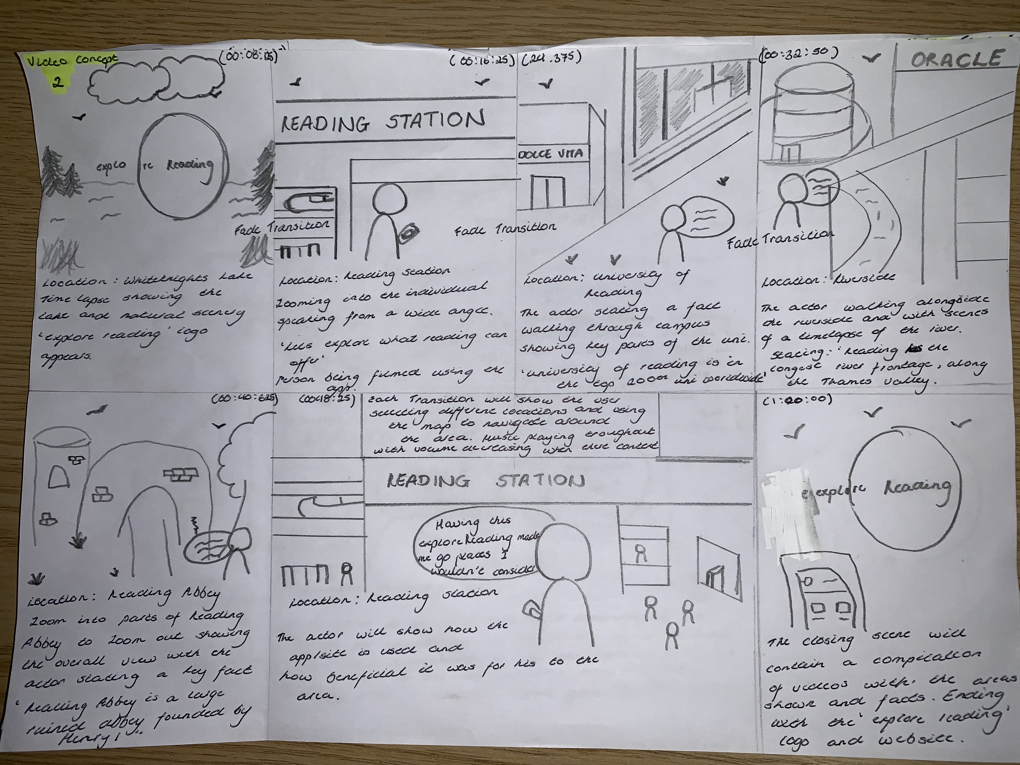
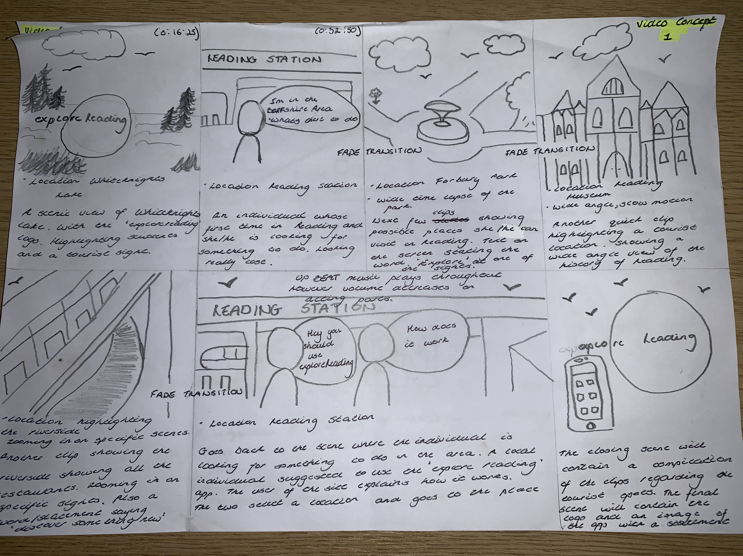
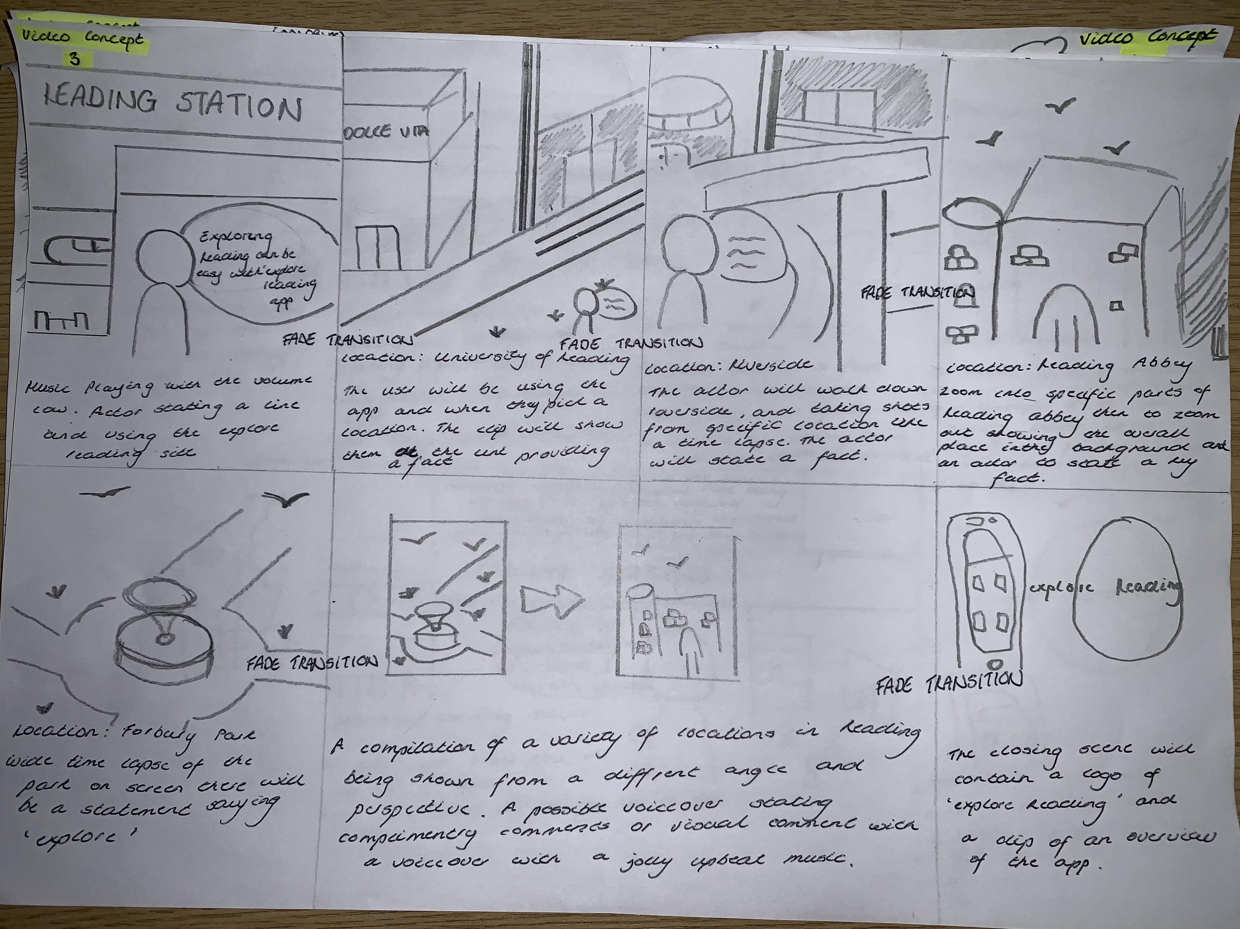
Possible Video Ideas

Slide 6
Final Video Story Board

Slide 7
Introduction to the Problem
Brief introductory clip of White Knights Lake. Video taken during the day.
Fade in transition of ”Explore Reading” logo.
Upbeat music playing in the background. Fades silently into next scene.
Clip of White Knights Lake would be a time-lapse take from a wide angle.

Slide 8
A look at the problem and Rising Action
A wide shot of the actor arriving in Reading Station during the day. Then goes into a wide-medium shot of the actor looking for something to do.
Zooms into the actor looking on the “Explore Reading” app. Filmed outside the station
Looks on the features that the app offers.
A screencast scrolling through the app with a low volume music playing in the background
Fade Transition into next scene.

Slide 9
Task 1:Browse
The actor is filmed on the University Reading Campus. From the previous scene where the attraction they wanted to visit was the university when selected on the app.
Actor stating how easy it was selecting a. attraction.
Further providing a fact that the actor has learnt.
Filmed on typical university day, filmed on a wide-medium angle.
Can possibly show other features of the uni.
Low volume music playing in the background.
Fade Transition into the next scene.

Slide 10
Task 2: Find
The actor is then filmed at the Oracle. From the previous scene where they demonstrated browsing through the attractions. The actor used the interactive map once the new attraction is picked and used one of the suggested form of transport.
Actor stating how efficient the map was.
Further providing a fact that the actor has learnt regarding the attraction chosen.
Filmed on a wide-medium angle, showing a panoramic scene outside the Oracle.
Filmed during the day, allowing natural sunlight.
Low volume music playing in the background.
Fade Transition into the next scene.

Slide 11
Task 3: Recommend
The actor is then filmed at Reading Abbey. From the previous scene where they demonstrated browsing through the attractions. The actor doesn’t know where to go so they use the recommendations provided on the app. The actor used the recommendations to select a new attraction.
Actor stating the benefits of using the recommendation feature.
Further providing a fact that the actor has learnt regarding the attraction chosen.
Filmed on a wide-medium angle, showing a panoramic scene outside the Abbey.
Filmed on a natural sunny day
Filming a 360 clip of the abbey.
Low volume music playing in the background.
Fade Transition into the next scene.

Slide 12
App Overview
Once all key features of the app is shown. The final acting scene is taken back to Reading Station. The actor is then providing a positive overview of the app and how it has benefitted there trip to the Berkshire Area.
Actor stating the benefits of using the “Explore Reading” app.
Filmed on a wide-medium angle, showing panoramic scene outside the Station and the actor using the app.
Filmed on a natural sunny day
Low volume music playing in the background.
Fade Transition into the next scene.

Slide 13
Closing Scene
The closing scene will contain a compilation of all 3 feature being shown, with a slight increase in video speed acting like a time-lapse effect.
The last compilation video will have a fade in of the “Explore Reading” logo.
Low volume music playing in the background.

Slide 14
Final Video

